Slide 1

INTERNSHIP PROJECT
IoT-Based Industrial Machine Monitoring and Cable Fault Visualization Using ESP8266
Embedded Systems Engineering · ESP8266 NodeMCU Platform

Slide 2
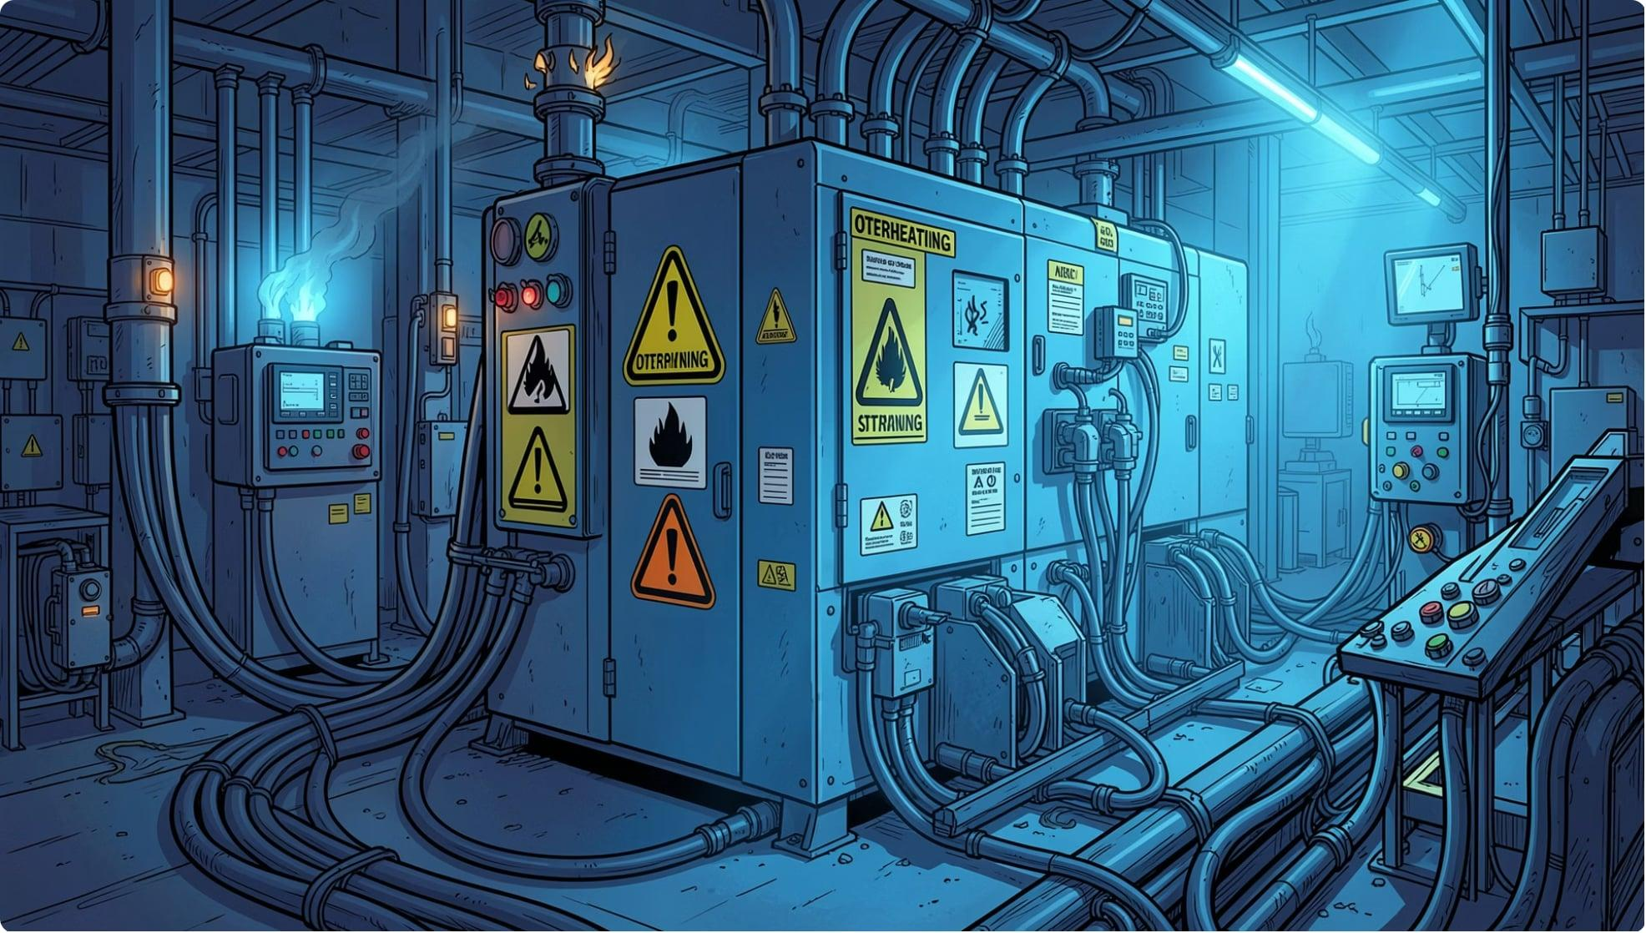
PROJECT OVERVIEW
Problem Statement & Objectives
The Challenge
Industrial machines operate without real-time temperature or vibration monitoring, leading to undetected failures
Cable faults in industrial electrical systems are difficult to identify and monitor in real time
Manual inspection is slow, costly, and unsafe
Project Objectives
Monitor machine health parameters continuously via IoT sensors
Detect and display cable fault levels in real time
Deliver a live web dashboard with remote alarm acknowledgment

Slide 3





COMPONENTS
Hardware & Software Stack
Hardware
Software
ESP8266 NodeMCU
DHT11 Sensor
Wi-Fi enabled microcontroller — core processing unit
Temperature & humidity monitoring
Arduino IDE
ESP8266 Web Server
Firmware development & serial upload
Embedded HTTP server for live data streaming
SW-420 Vibration Sensor
Potentiometer + Push Button + Buzzer
Machine vibration anomaly detection
Cable fault simulation, alarm acknowledgment, and alert output
HTML / CSS Dashboard
Responsive browser-based monitoring interface

Slide 4

ARCHITECTURE
System Architecture
Web Dashboard
Alarm & Buzzer
Sensors
ESP8266
All sensor data is aggregated by the ESP8266, transmitted over Wi-Fi, and rendered on a local web dashboard. Threshold breaches trigger an audible alarm, acknowledged via push button.

Slide 5





WORKING PRINCIPLE
How the System Operates
Temperature Monitoring
Vibration Detection
Cable Fault Visualization
DHT11 samples ambient and machine temperature at fixed intervals, transmitted live to dashboard
SW-420 detects abnormal mechanical vibration; threshold breach flags machine anomaly
Potentiometer simulates different cable fault conditions, and the ESP8266 visualizes the corresponding fault level on the web dashboard.
Live Web Dashboard
Alarm Acknowledge
Built-in web server hosts HTML/CSS interface — accessible from any browser on the network
Buzzer triggers on fault; push button silences alarm and logs acknowledgment event

Slide 6
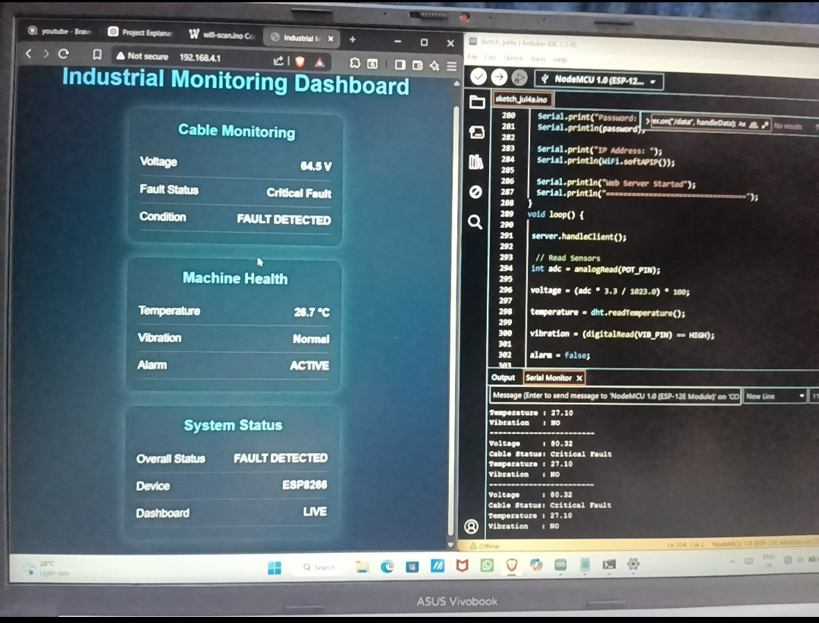
RESULTS
Dashboard Output & System Performance
Live Monitoring Parameters
Dashboard Screenshots
🌡️ Temperature
⚡ Cable Fault Visualization
Real-time DHT11 readings displayed in °C with threshold alert
Fault severity indicator based on potentiometer input simulation
〰️ Vibration Status
🔔 Alarm Status
Normal / Anomaly state from SW-420 sensor output
Active / Acknowledged state with push-button reset confirmation

Slide 7

CONCLUSION
Key Takeaways & Future Scope
Advantages
Future Scope
Low-cost, scalable IoT architecture using ESP8266
Real-time remote monitoring without dedicated infrastructure
Immediate fault alerts with acknowledgment workflow
Integrate cloud platforms (AWS IoT / Blynk) for remote access beyond LAN
Add machine learning for predictive fault analysis
Industrial Applications
Manufacturing floor machine health monitoring
Industrial electrical distribution monitoring
Smart factory predictive maintenance systems
Expand sensor array: current, voltage, and acoustic sensors
Deploy GSM/LTE module for offline industrial environments

Slide 8
THANK YOU!
Thank you for your valuable time.

